Slide 1
Movie Recommendation System
Lokesh Yadav
BCA+MCA
A50549515005

Slide 2
Content:
Project Overview
Recommender System: User-Based Collaborative Filter
Recommender System: User-Based Collaborative Filter Limitations
Recommender System: Item-Based Collaborative Filtering
Technology used
Screenshots
Conclusion & Future-scope
References

Slide 3
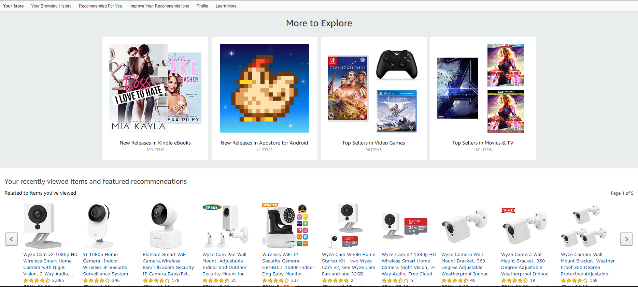
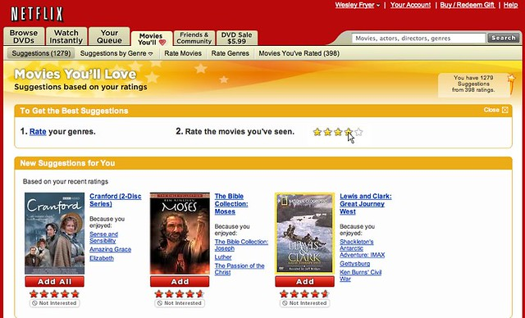
PROJECT OVERVIEW
Recommender systems are algorithms designed to help users discover movies, products, and songs by predicting the user’s rating of each item and displaying similar items that they might rate high as well.
The objective is to show customers content that they would like best based on their historical activity.
Photo Credit: https://www.flickr.com/photos/wfryer/2661730729

Slide 4



RECOMMENDER SYSTEMS: USER-BASED COLLABORATIVE FILTER
User-based collaborative filtering works by building a matrix of every piece of content that users bought or viewed.
Similarity scores are then calculated between users to find similar users to each others.
For similar users, content that have not been viewed or bought are recommended to users that haven’t seen them before.
SIMILAR USERS

Slide 5
RECOMMENDER SYSTEMS: USER-BASED COLLABORATIVE FILTER LIMITATIONS
More users than products, movies..etc. so making the problem more complex (~8 billion people!)
Users taste change over time.
Let’s explore another strategy that overcomes the limitations of User-based collaborative filtering. This strategy is named item-based collaborative filtering.

Slide 6
RECOMMENDER SYSTEMS: ITEM-BASED COLLABORATIVE FILTERING
Based on User #1 and #2, they both watched and liked Titanic and a walk to remember.
Item-based collaborative filtering will correlate both movies together based on user #1 and #2 behaviour.
User #3 watched “Titanic” and did not watch a “Walk to remember”, so the recommender system will recommend it for him/her.
SIMILAR ITEMS

Slide 7
Technology Used
Python: Python is an interpreted, high-level, general-purpose programming language. Created by Guido van Rossum and first released in 1991, Python's design philosophy emphasizes code readability with its notable use of significant whitespace. Its language construct and object-oriented approach aim to help programmers write clear, logical code for small and large-scale projects
Machine learning: Machine learning (ML) is the study of computer algorithms that improve automatically through experience. It is seen as a subset of artificial intelligence. Machine learning algorithms build a mathematical model based on sample data, known as “training data”, in order to make predictions or decisions without being explicitly programmed to do so.

Slide 8
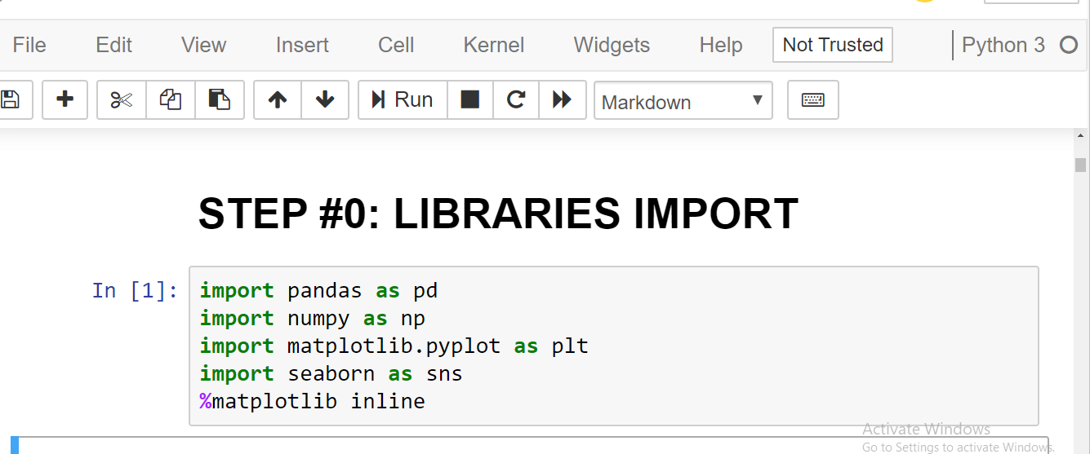
Screenshots

Slide 9
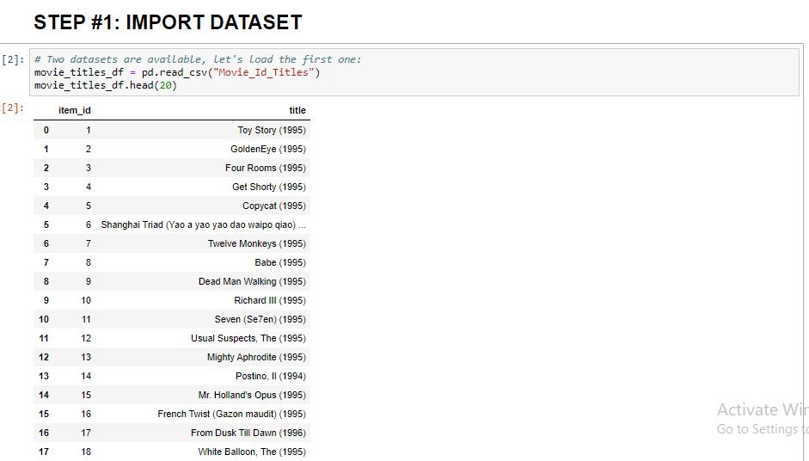
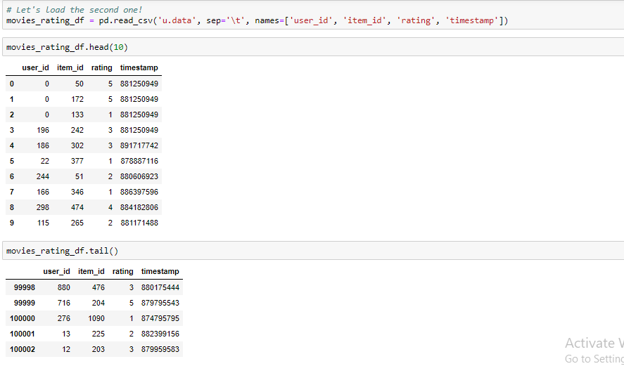
Dataset

Slide 10
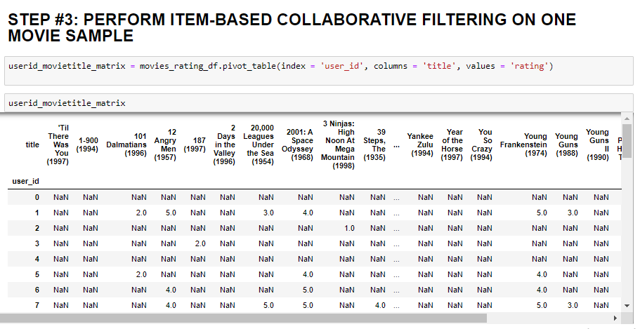
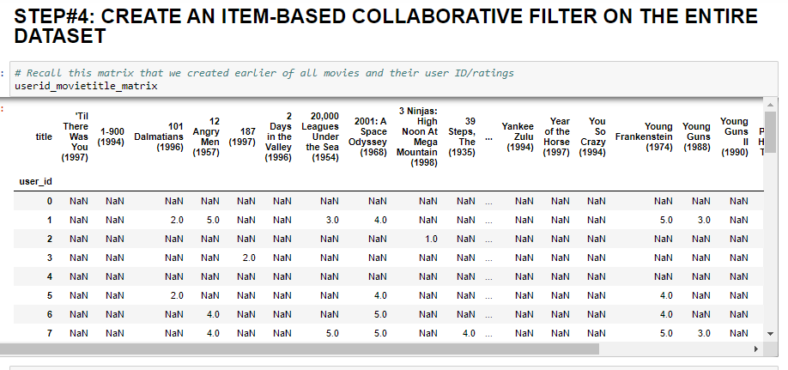
Collaborative filtering

Slide 11
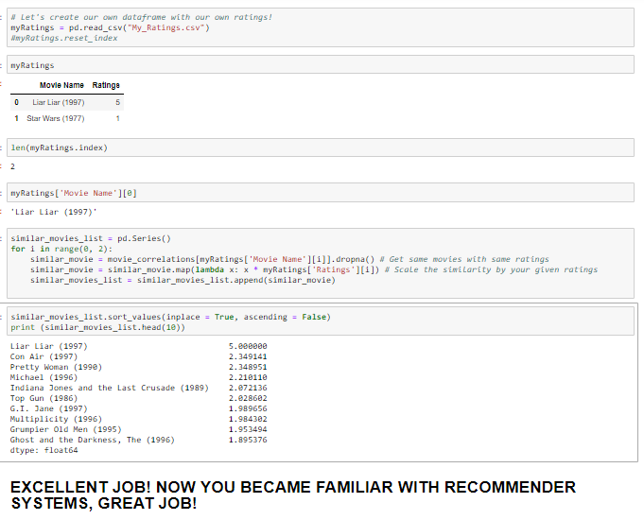
Result

Slide 12
Conclusion & Future Scope
We come up with a strategy that focuses on dealing with user’s personal interests and based on his previous reviews, movies are recommended to users. This strategy helps in improving accuracy of the recommendations. A personal profile is created for each user, where each user has access to his own history, his likes, ratings, comments, password modification processes.
A hybrid approach is taken between context based filtering and collaborative filtering to implement the system. This approach overcomes drawbacks of each individual algorithm and improves the performance of the system.
In future we can work on hybrid recommender using clustering and similarity for better performance. Our approach can be further extended to other domains to recommend songs, video, venue, news, books, tourism and e-commerce sites, etc.

Slide 13
References:
https://grouplens.org/datasets/movielens/100k/: Movie Lens Data Set
https://codeburst.io/explanation-of-recommender-systems-in-information-retrieval-13077e1d916c: Collaborative Filtering

Slide 14
THANK
YOU

